Slide 1


Operating System Simulator ToolKit ( Analysis, Anomalies Detection & Recovery)
Content of Project Presentation:
What is this project?
Technologies Used.
Features Overview.
Why it matters (Real Life Application)
In-depth feature Review.
Syed Hassnain Abbas
23P-3029
BSE-4A

Slide 2
What is this project?
It is a operating system simulation toolkit which monitors operating system memory, analyzes CPU usage. analysis is done then logic is applied to identifies anomalies, and provides recovery mechanisms to address real-world OS-level challenges

Slide 3
Technologies Used
Programming Language:
C++ → implementation for process handling, memory management, and file recovery simulations.
Linux System
/proc filesystem → Real-time access to process and system data.
Signals (SIGKILL) → Used to manage and terminate zombie process parents.
Visualization Tools
Gnuplot → Used for live graph plotting of memory and CPU usage.
System Tools & Techniques
Manual File Parsing → Reading and analyzing /proc/stat, /proc/[pid]/status, etc.

Slide 4

Overview of Key Features
Zombie Process Detection & Handling
Features
Memory Monitoring Tool
CPU Usage Analysis
File Recovery System

Slide 5

Why It Matters: Real-World Applications
File Recovery System
Zombie Process Detection & Handling
Power loss or crashes leading to lost data.
Tool Benefit: Simulates and recovers corrupted files after a crash.
Zombie Processes can block PID tables, preventing new processes from running.
Tool Benefit: Auto-detects and kills zombie parents, freeing up PID space.
Memory Monitoring Tool
CPU Usage Analysis
In large-scale systems, memory leaks can silently degrade performance and can take down servers, this tool helps identify abnormal memory usage in real-time.
Tool Benefit: Graphs memory usage per PID, identifying abnormal consumption.
high CPU usage can lead to slow response times, increased latency, and even server crashes.
Tool Benefit: Monitoring CPU usage helps identify bottlenecks and optimize resource allocation.

Slide 6
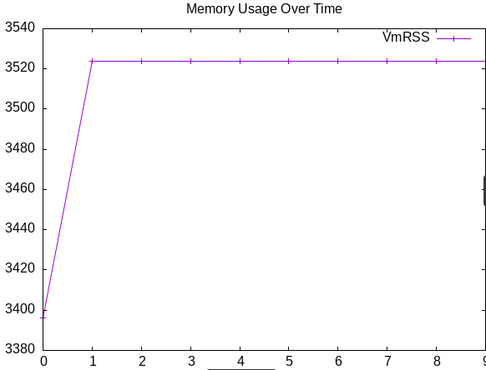
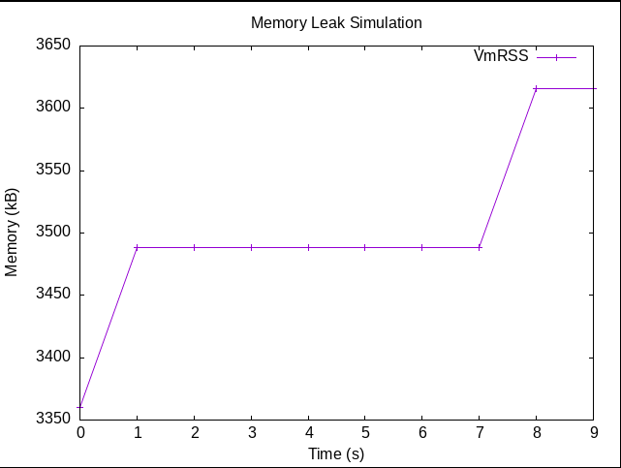
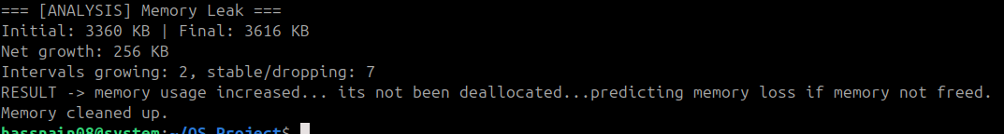
Memory Usage Monitoring
How It Works
Extract "VmRSS" Virtual Memory Resident Set Size from /proc/[pid]/status
Log memory every second
Plot with Gnuplot

Slide 7

Zombie Process Detection & Handling
How It Works:
Iterate through /proc/*/status
Identify "State: Z" processes (Z = Zombie)
Extract Parent PID from /proc/[pid]/stat
Auto-send SIGKILL to parent

Slide 8
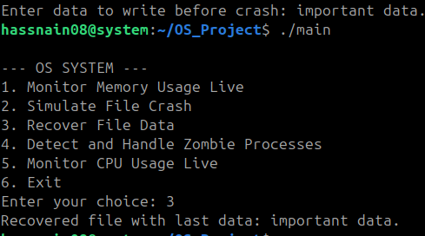
File System Recovery Simulation

Slide 9
CPU Usage Analysis
How It Works:
Parse /proc/stat to get CPU states
Compute CPU utilization = 100 - Idle %
Plot with Gnuplot every second based on different CPU time components.
How It Works:
Parse /proc/stat to get CPU states
Compute CPU utilization = 100 - Idle %
Plot with Gnuplot every second based on different CPU time components.
CPU time components:
user: Time spent running normal-priority user processes (e.g -> your applications).
nice: Time spent running low-priority (nice) user processes.
system: Time spent running kernel-level tasks (e.g., handling system calls).
idle: Time spent doing nothing (CPU is idle).
iowait: Time spent waiting for I/O operations (e.g., disk or network activity).
irq: Time spent handling hardware interrupts (e.g., keyboard/mouse input).
softirq: Time spent handling software interrupts (e.g., kernel ).

Slide 10
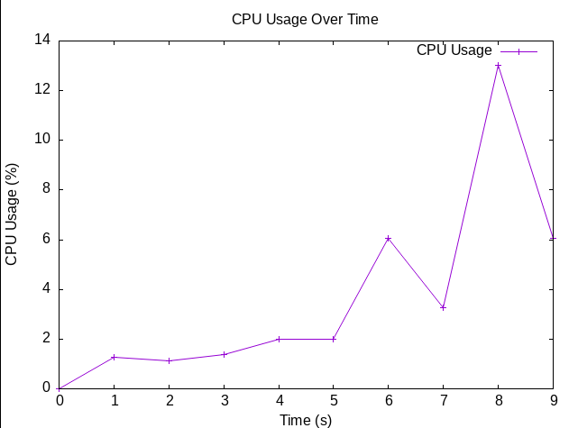
CPU Usage Analysis

Slide 11
Challenges & Limitations
1. No GUI integration yet
2. Mostly simulated, but it gives an idea of how it shows what problems of os/linux may occur and its solutions, and how it could be built up to like a full system, consider this as a prototype

